Slide 1
Require.js
Lets make JavaScript modular

Slide 2
Agenda for Day1
Introduction to Javascript
Why use require.js
Basic Introduction to Require.js
Environmental Setup
Simple Require.js Module Example

Slide 3
Agenda for Day2
Configuration Options available
Setting up Backbone.js with require
Using Require.js plugins
Unit testing modules with Jasmine

Slide 4

About me..
A JavaScript enthusiast.
Over 8+ years of experience working on JavaScript and related technologies.
Trainer, freelancer.
Experience working on Node.js, Angular.js, React.js
Contact :
Twitter : #linkswapnil ,
linkedIn : Swapnil Navalakha

Slide 5
JavaScript Basics
Worlds Largest used programming language

Slide 6
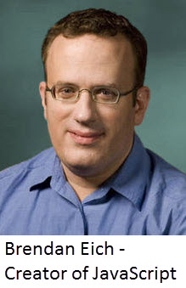
Introduction to JavaScript
JavaScript was developed by Brendan Eich in 1995, which appeared in Netscape, a popular browser of that time.
The language was initially called LiveScript and was later renamed JavaScript.
There are many programmers who think that JavaScript and Java are the same. In fact, JavaScript and Java are very much unrelated.
The syntax of JavaScript is mostly influenced by the programming language C.

Slide 7
Where JavaScript Runs ?
Prior to introduction of Node.js JavaScript was just a language that could run on browser.
As a programmer we don’t need to worry about the OS as every modern browser supports JavaScript
To start with, you need a text editor to write your code and a browser to display the web pages you develop.

Slide 8
JavaScript Key features
Event based
Functions are first class citizens
Dynamically typed
var x; Vs int x=10;
x=10;
Single threaded
Closures
Prototypal Inheritance

Slide 9
JavaScript datatypes
Primitive Types
String
Number
Boolean
Undefined
Reference Types
Object
Array
Function
Date
Regex

Slide 10
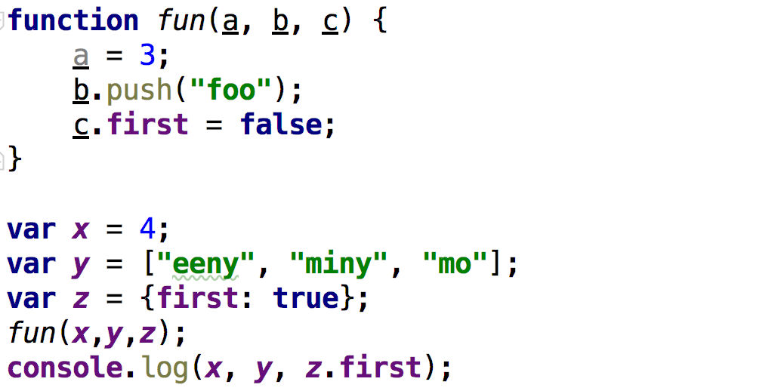
Guess the output

Slide 11
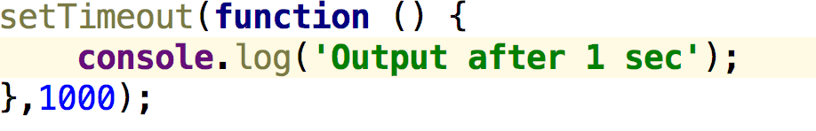
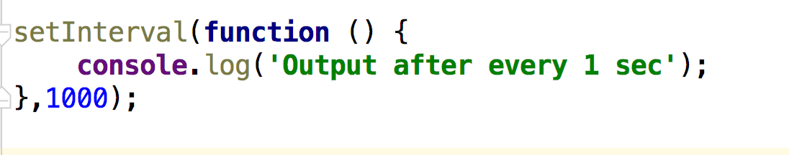
Timer functions
SetTimeout()
The setTimeout() method calls a function or evaluates an expression after a specified number of milliseconds.
SetInterval()

Slide 12
Timer functions
clearTimeout()
The clearTimeout() method clears a timer set with the setTimeout() method.
clearInterval()
The clearInterval() method clears a timer set with the setInterval() method.

Slide 13
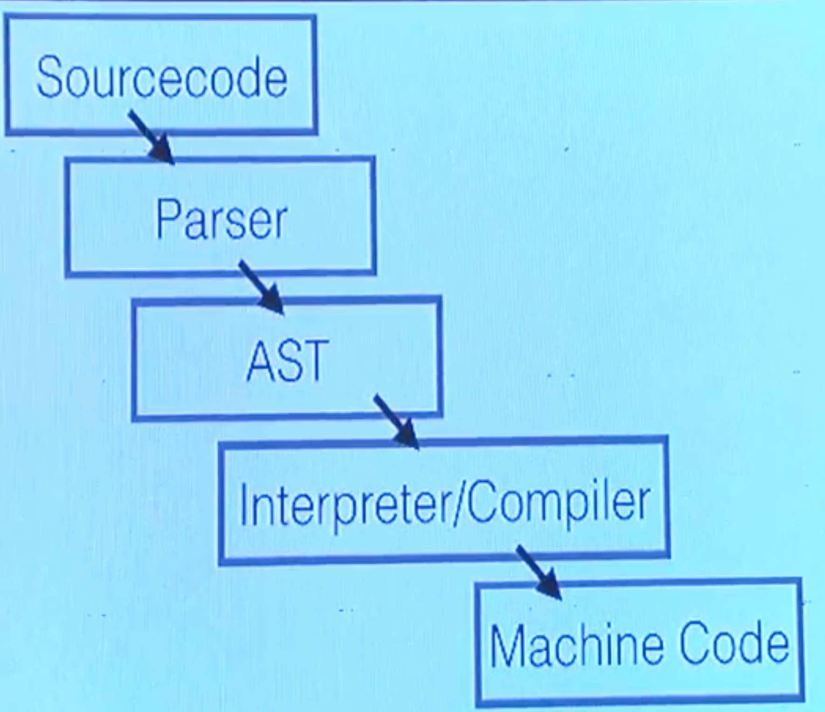
How JavaScript Executes ?

Slide 14
Just In Time Compilation (JIT)
Generate machine code during runtime, not ahead of time (AOT).

Slide 15
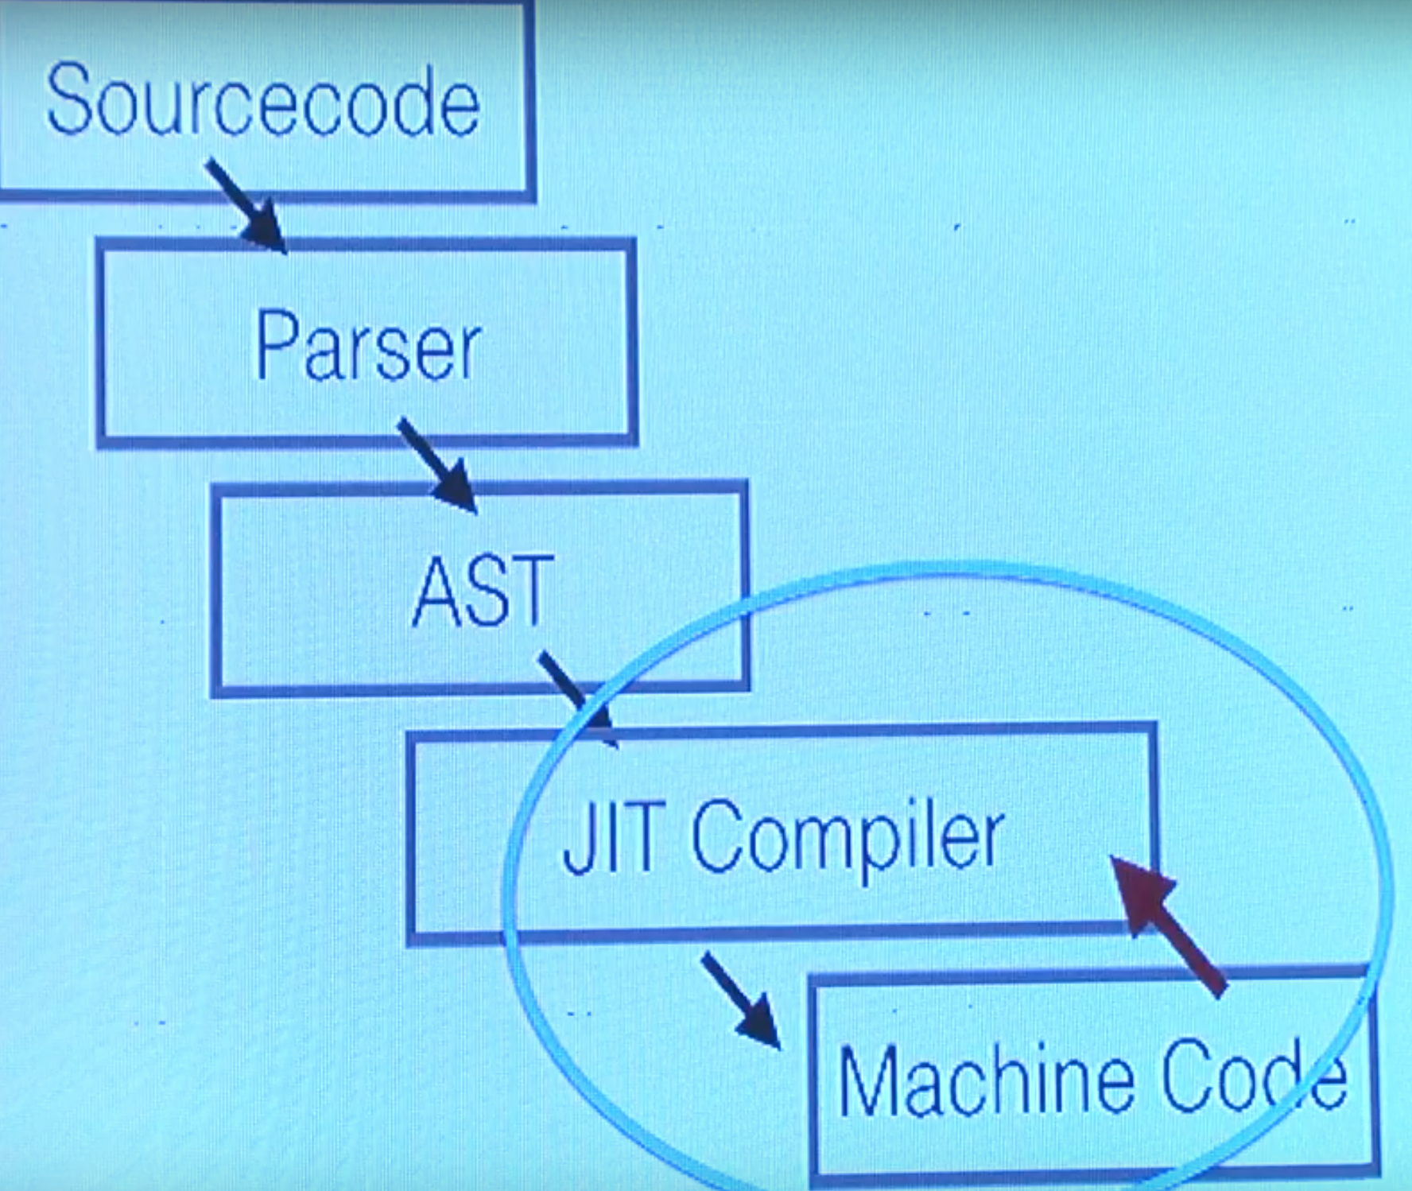
JIT

Slide 16
JavaScript Execution
JavaScript is executed in two phases
Compilation Phase
Executions Phase
During compilation phase JavaScript engine just prepares the memory with references.
During execution phase JavaScript engine assigns values to the references

Slide 17
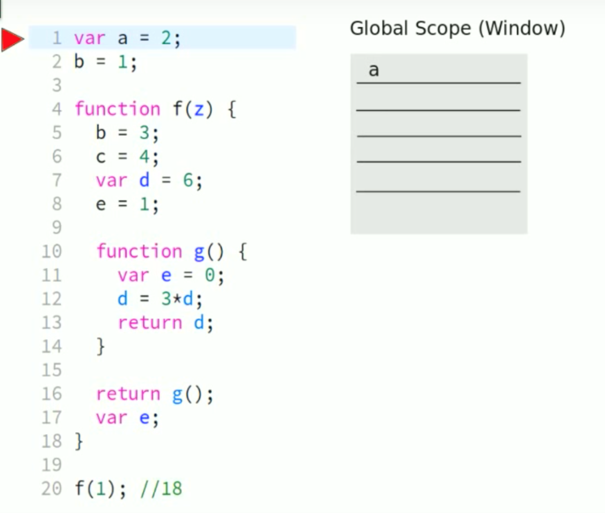
JavaScript Execution

Slide 18
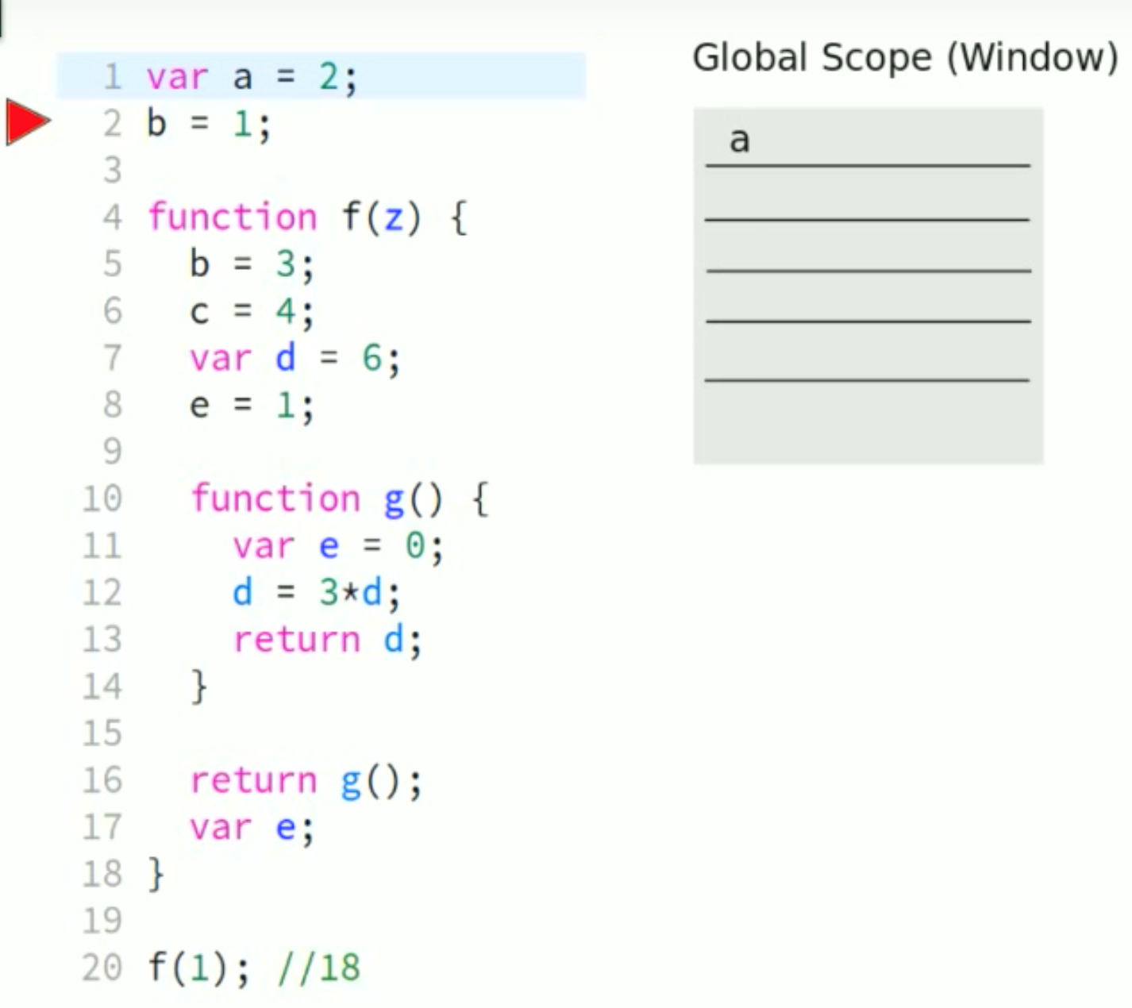
JavaScript Execution

Slide 19
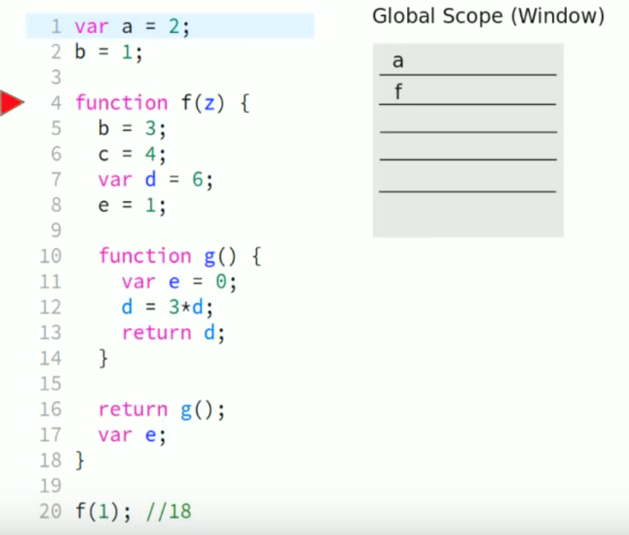
JavaScript Execution

Slide 20
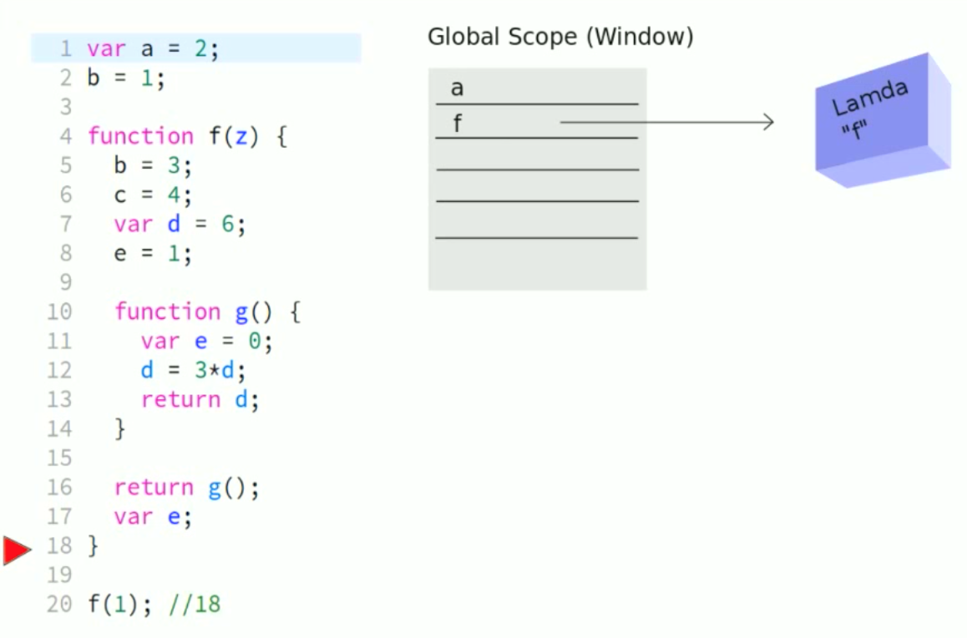
JavaScript Execution

Slide 21
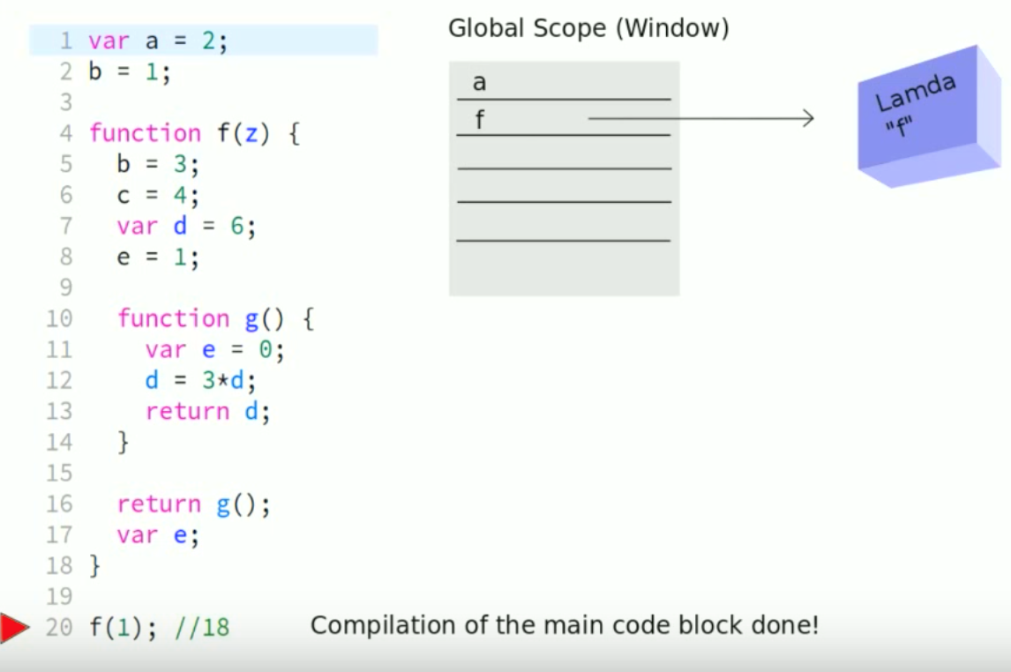
JavaScript Execution

Slide 22
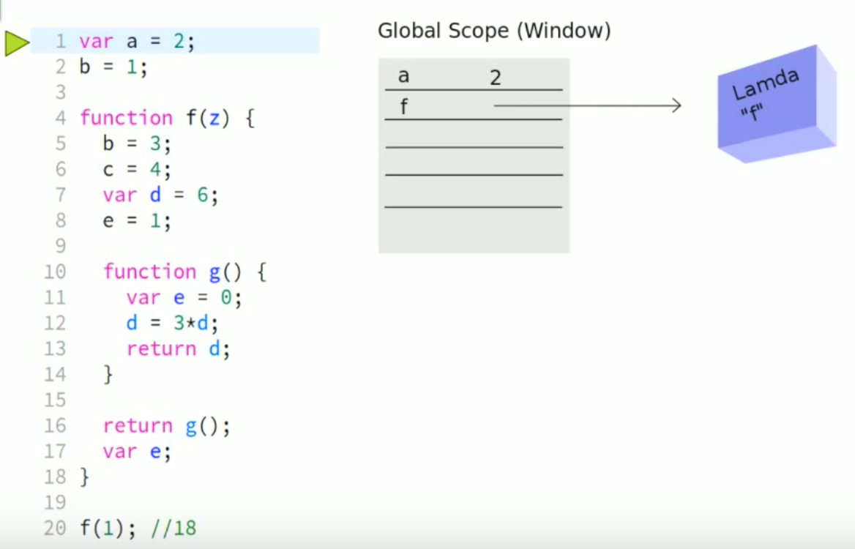
JavaScript Execution

Slide 23

JavaScript Execution

Slide 24
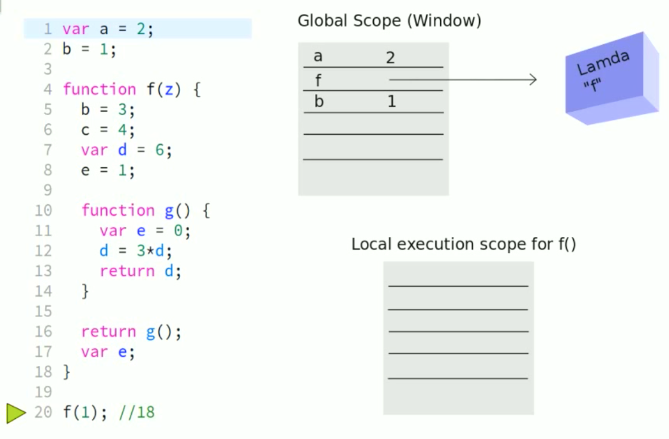
JavaScript Execution

Slide 25
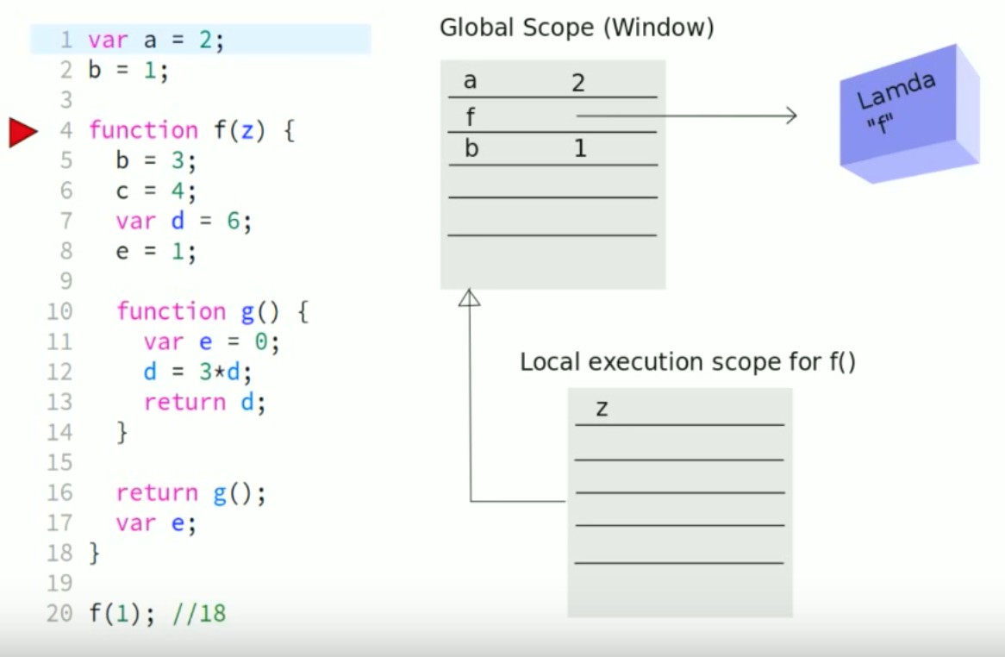
JavaScript Execution

Slide 26
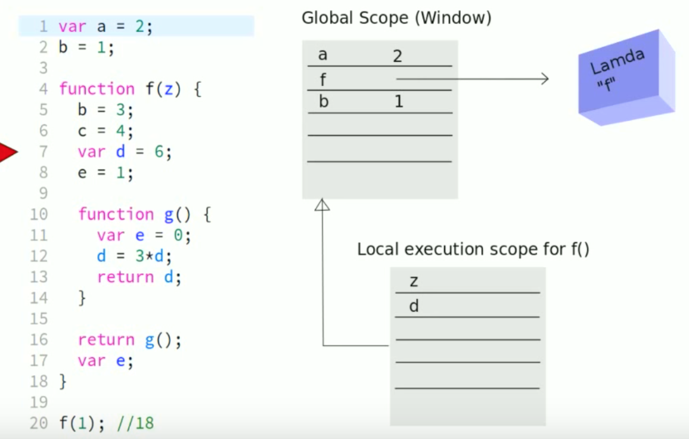
JavaScript Execution

Slide 27
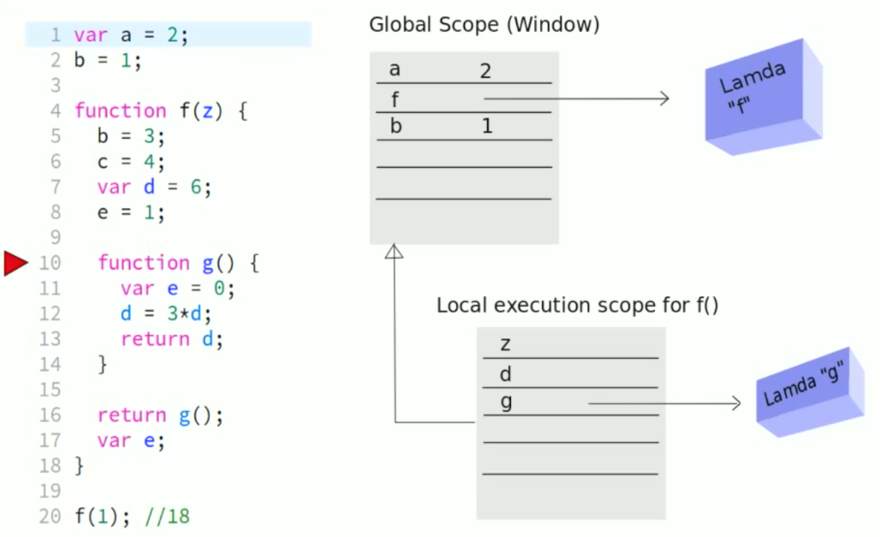
JavaScript Execution

Slide 28
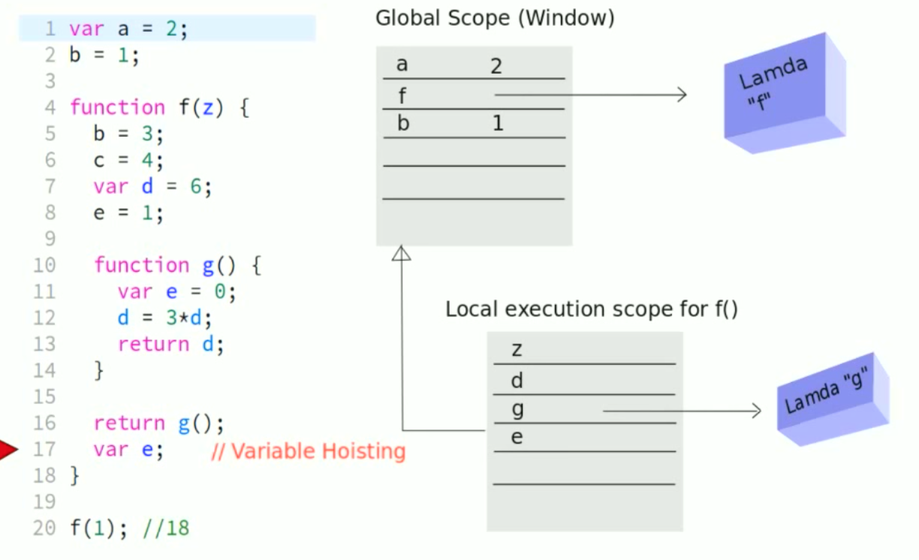
JavaScript Execution

Slide 29
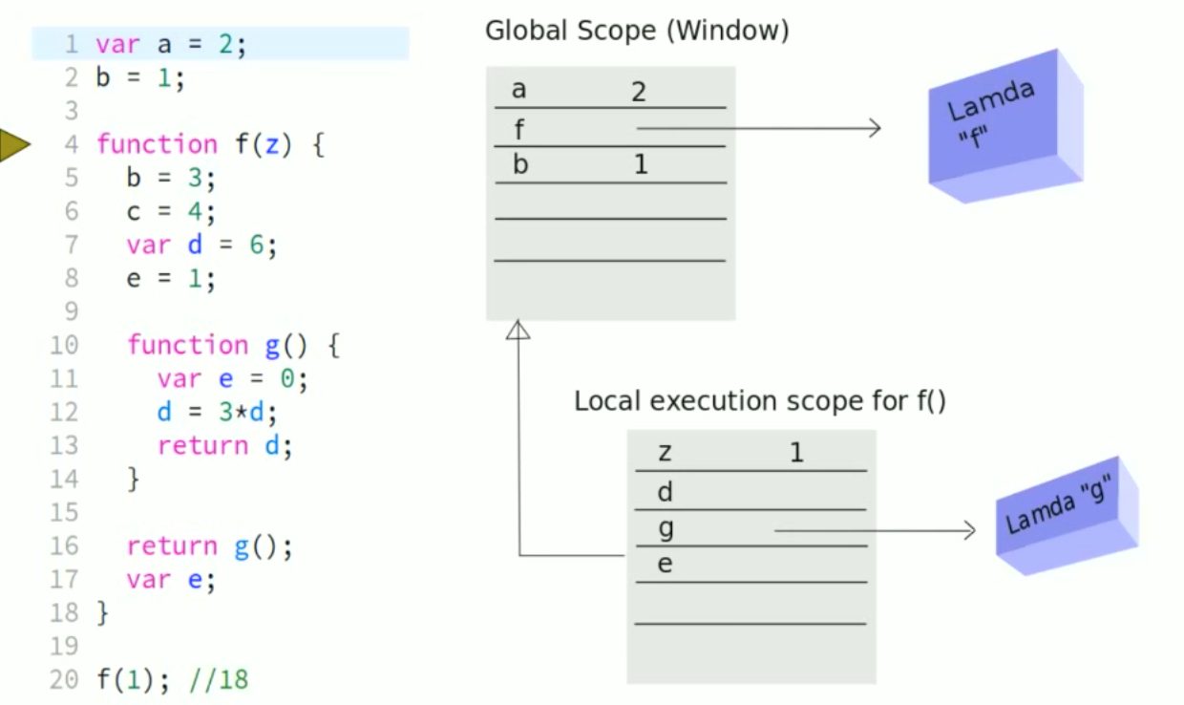
JavaScript Execution

Slide 30
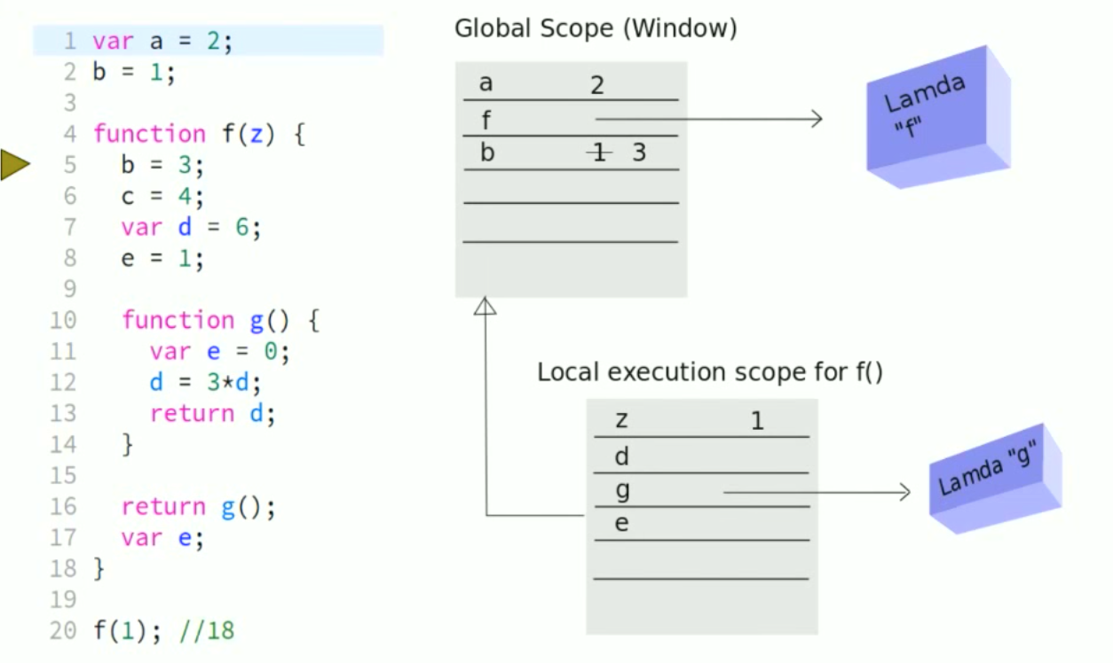
JavaScript Execution

Slide 31
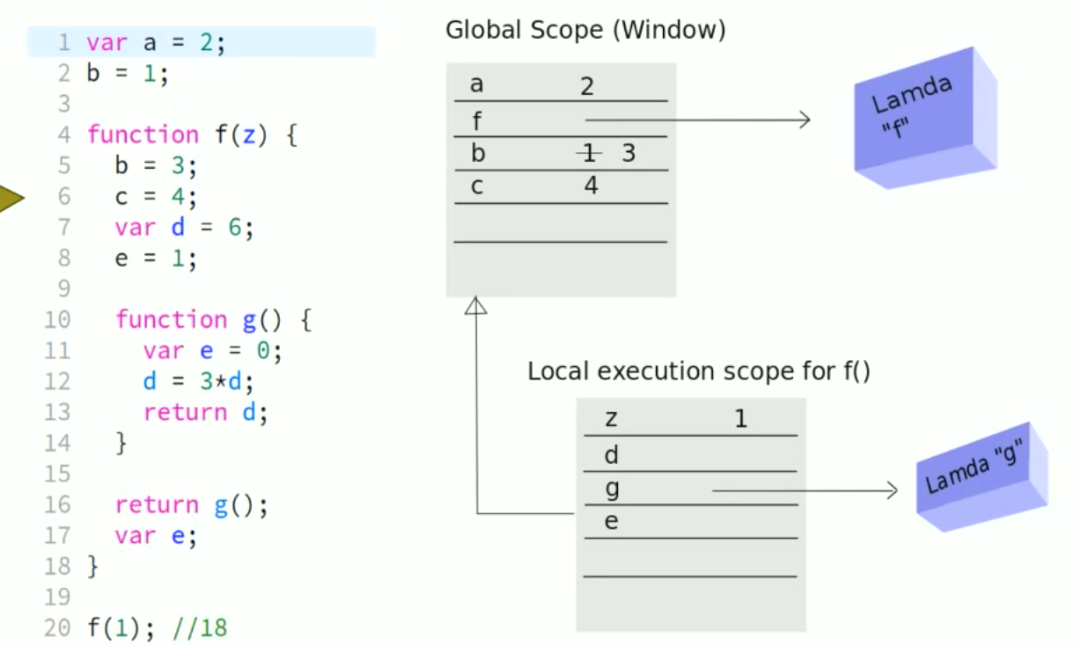
JavaScript Execution

Slide 32
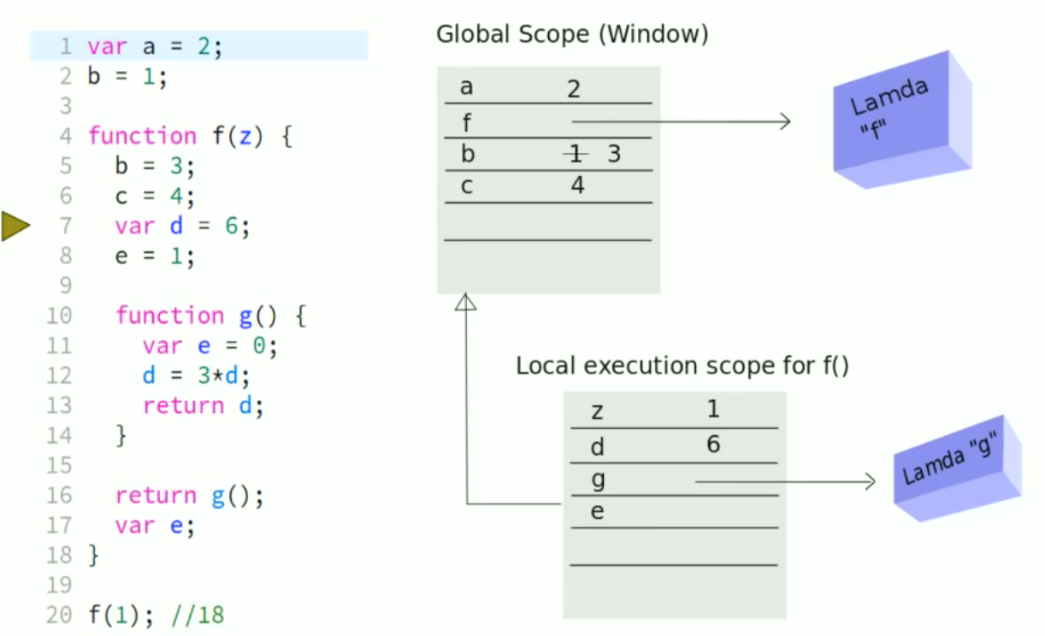
JavaScript Execution

Slide 33
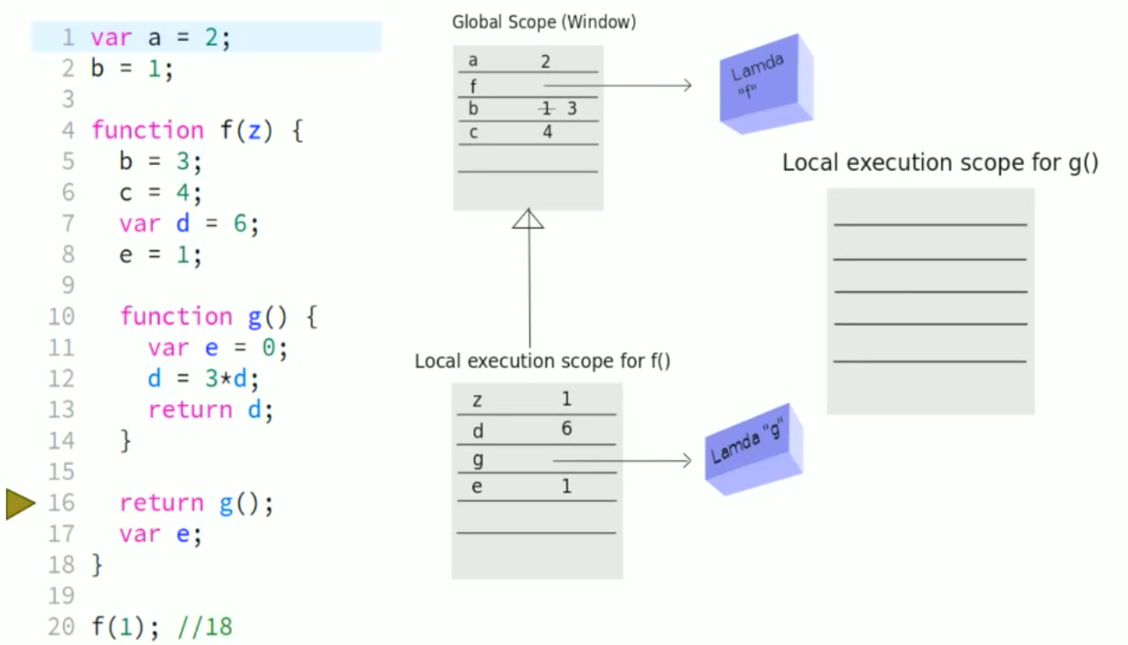
JavaScript Execution

Slide 34
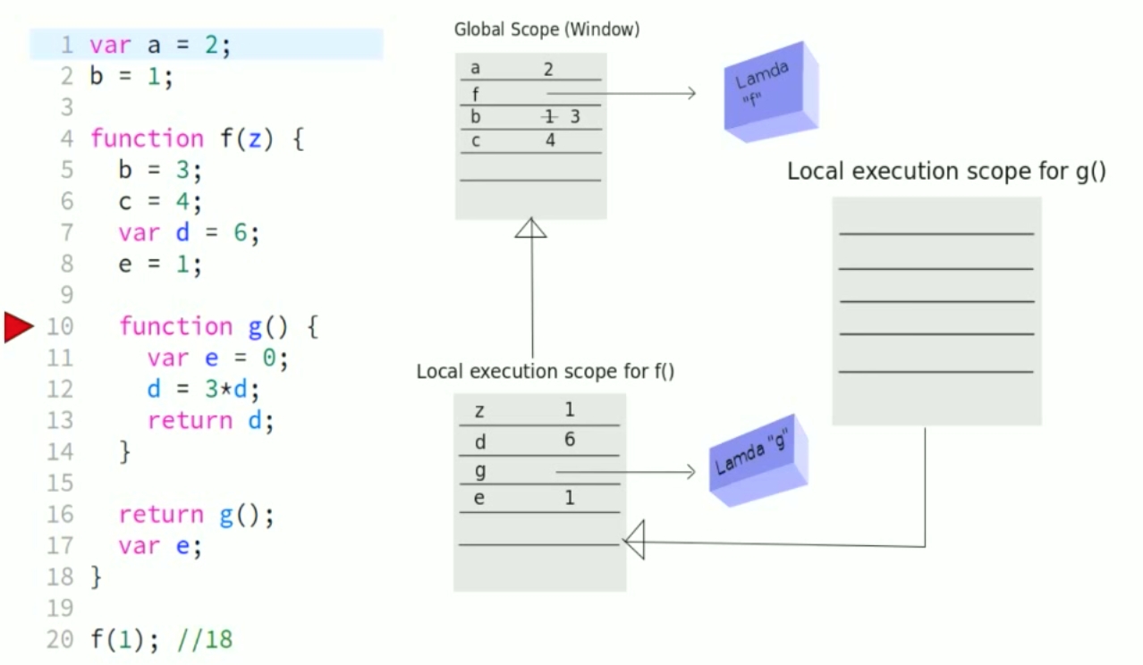
JavaScript Execution

Slide 35
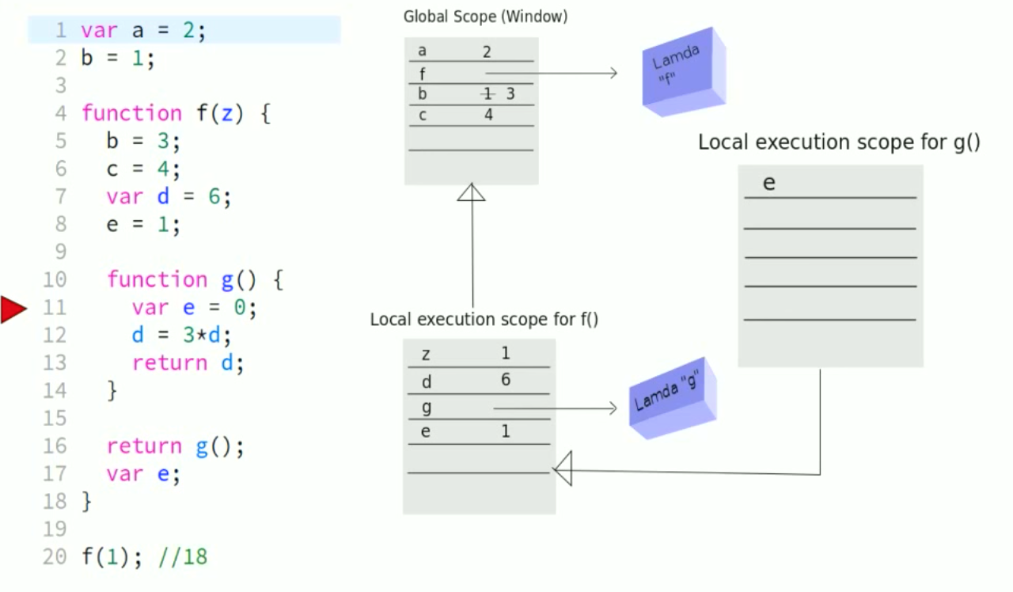
JavaScript Execution

Slide 36
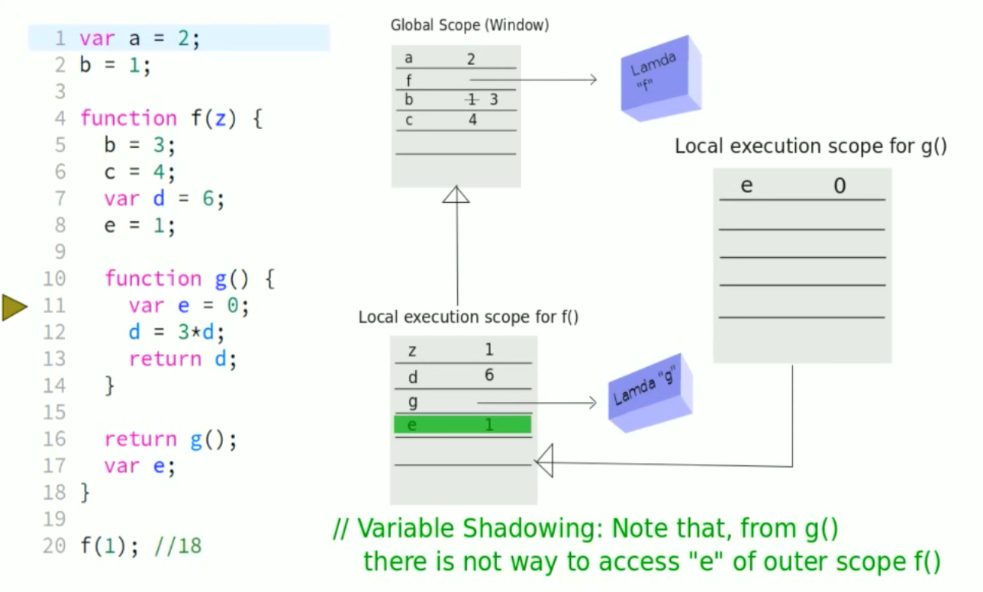
JavaScript Execution

Slide 37
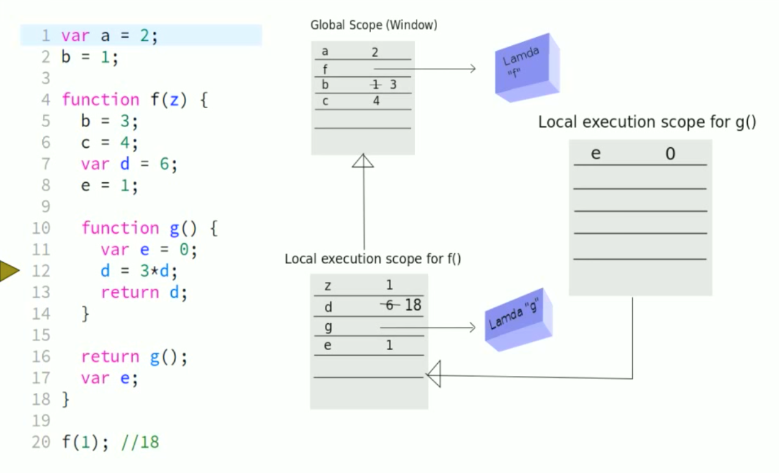
JavaScript Execution

Slide 38
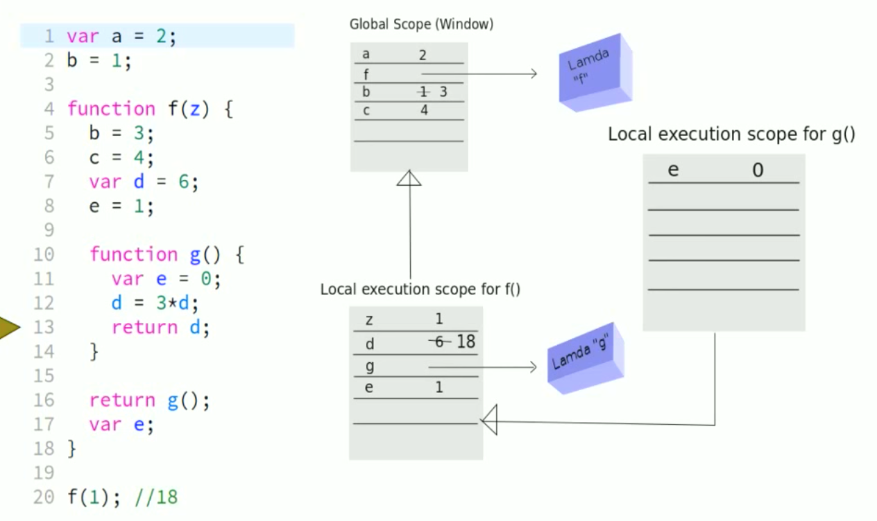
JavaScript Execution

Slide 39
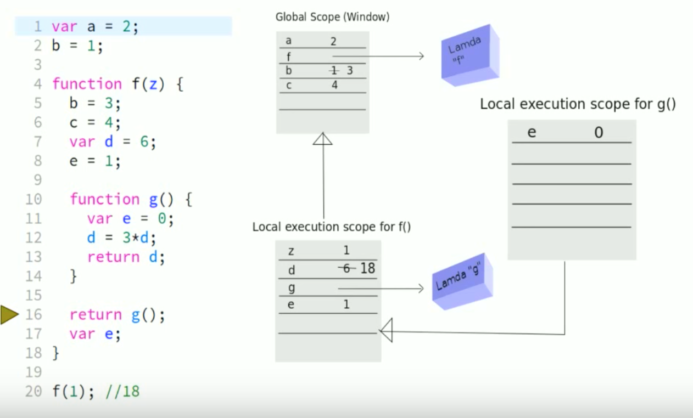
JavaScript Execution

Slide 40
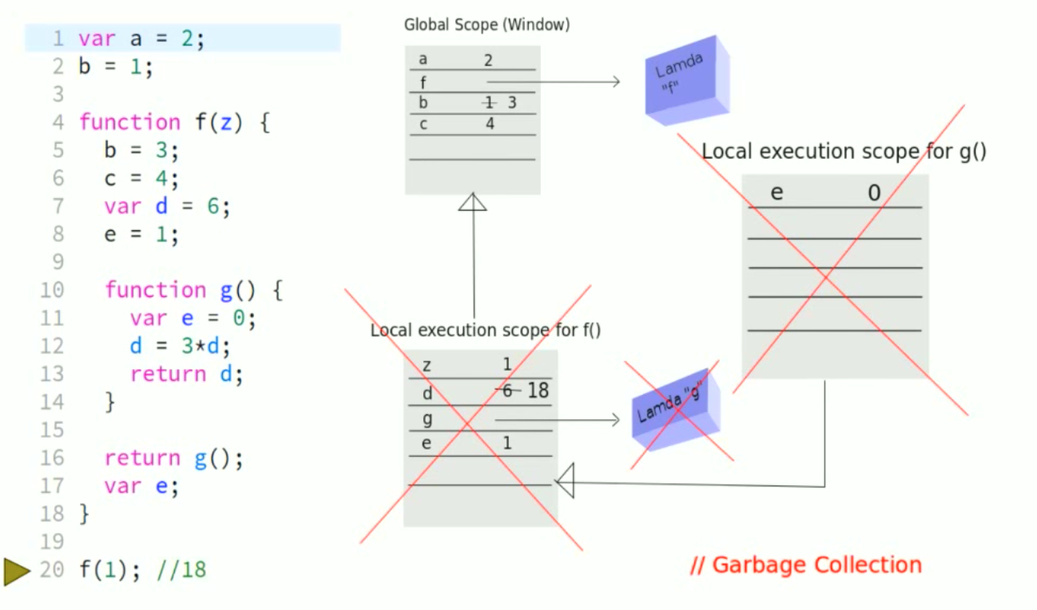
JavaScript Execution

Slide 41
Closures
A closure is an inner function that has access to the outer (enclosing) function's variables—scope chain
The closure has three scope chains:
it has access to its own scope (variables defined between its curly brackets)
it has access to the outer function's variables
and it has access to the global variables
Closure Example

Slide 42
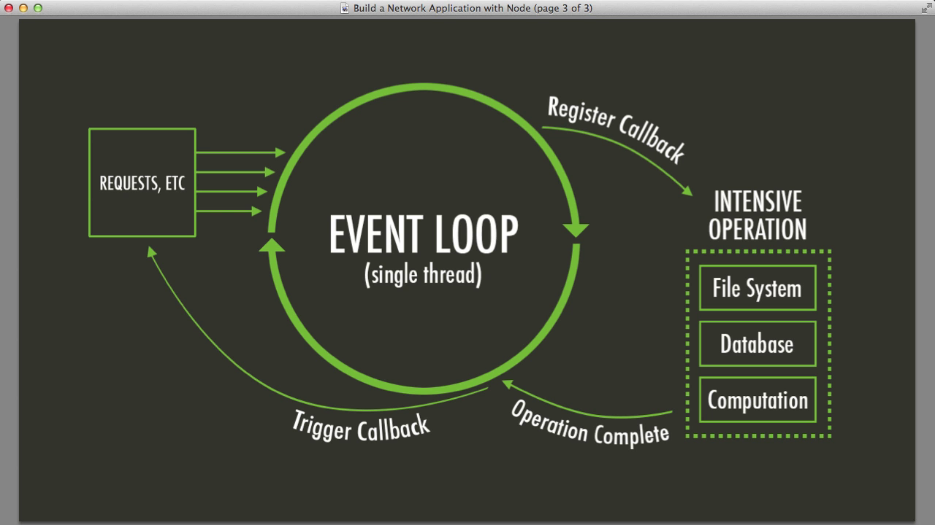
Event Loop

Slide 43
Blocking Vs Non Blocking
JavaScript is single threaded
Blocking refers to operations that block further execution until that operation finishes
Non-blocking refers to code that doesn't block execution

Slide 44
Sync Vs Async
// Synchronous:
alert(1);
alert(2);
alert(3);
// Asynchronous:
alert(1);
setTimeout(() => alert(2), 0);
alert(3);

Slide 45
How Script tag works
Script tags are executed in the order they appear
<script> var x = 3;</script>
<script> alert(x);</script>
<script src="//typekit.com/fj3j1j2.js"></script>
<!-- This second script won’t execute until typekit has executed, or timed out -->
<script src="//my.site/script.js"></script>

Slide 46
How Script tags works
One useful corollary of this is that document.head is virtually always available in any JavaScript you might write (on a webpage).
document.body is only available if your script tag appears inside or after the opening <body> tag.

Slide 47
Async attributes
async : means “execute this whenever”
It’s very useful for analytics tracking codes, for example, where no other code on the page depends on their execution
Defining a variable or function in async code which the page needs is bad news, as you have no way of knowing when the async code will actually run.

Slide 48
Defer
defer means “wait for the parser to finish to execute this”
It’s equivalent to binding your script to the DOMContentLoaded event, or using jQuery.ready.
When the code does run, everything in the DOM will be available for you to use.
It is just deferred until after the HTML is fully parsed

